Slide 1
Solutions Architect Hiring Assignment
July 2nd 2019
Hae-Yeon, Hwang

Slide 2
Executive Summary
My Goal
Proposal AWS cloud architecture for early stage start-up company who trying to launch a web application on AWS
Consideration
Proof of concept (PoC) stage, but want a deploy on AWS cloud.
Face a too many problem (failed in loading page at LAMP environment).
Guide a proper architecture to customer who need a clearly solution.

Slide 3
Assignment
Task #1
Trouble shoot the issue by modifying the misconfiguration generated by given CloudFormation template and load demo.html page thru ELB hostname
Task #2
Propose changes to the current implementation that would improve the reliability, security, cost, operation and performance before the project goes into production.

Slide 4
Task#1

Slide 5







Task #1 :: Target Architecture
AWS Cloud
ap-northeast-2a
ap-northeast-2c
Internet
Gateway
VPC
10.0.0.0/16
Public subnet
Public subnet
EC2
Application
Load Balancer
EC2
10.0.0.0/24
10.0.1.0/24
Private subnet
Private subnet
10.0.2.0/24
10.0.3.0/24

Slide 6



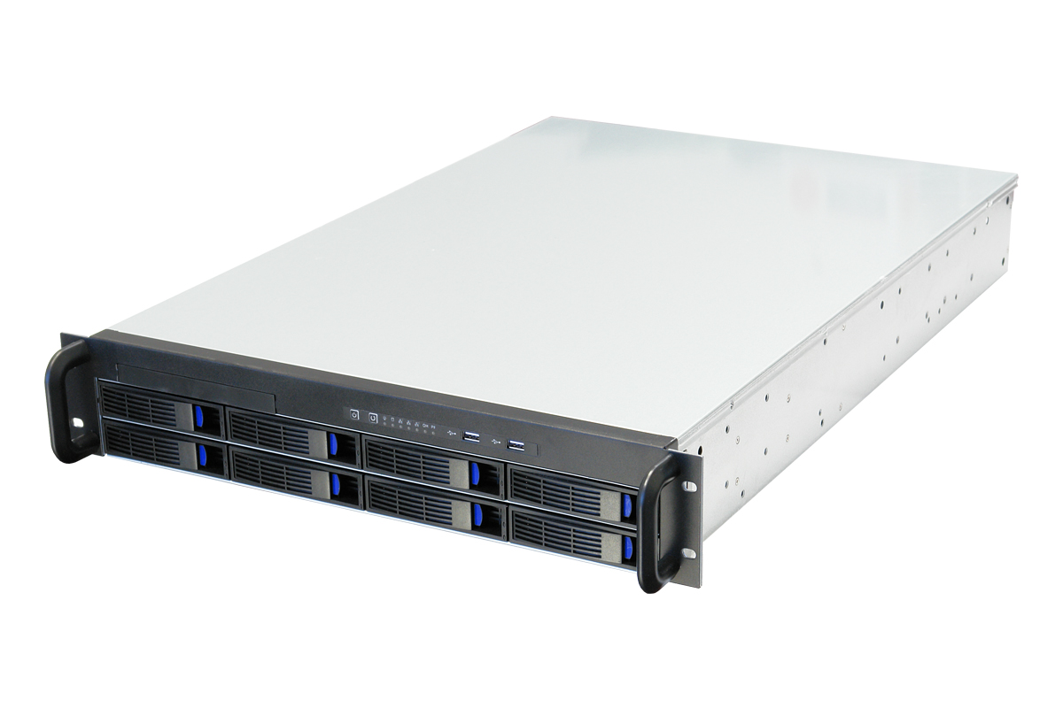
Task #1 :: Comparison, On-premise vs. AWS
Comparison | On-Premise | AWS
Gateway | Router | Internet Gateway
Load Balancer | L4/L7 switch | ELB (classic/network/application)
Subnet | VLAN(802.1q), L2/L3 switch | Subnet
Filter | Ingress/egress Filter | Security Group (In/outbound Rule)
LB Instance | Physical Server [Farm] | ELB registered EC2 instance
Security Entity | Firewall / iptables | ACL
Easy to use
Flexible
Cost-Effective
Reliable
Secure
Scalable and high performance

Slide 7
Task #1 :: Trouble Shooting (step-by-step)
Build VPC
VPC (My VPC, 10.0.0.0/16)
Subnet (Public 1/10.0.1.0/24, Public 2/10.0.2.0/24; auto-assign IP setting)
Internet Gateway (My IG; attach to VPC)
Route Table (add route 0.0.0.0/0; subnet associations)
Security Group (VPC; Inbound Rules: HTTP/Anywhere)
Launch a EC2 and ELB/ALB
Launch EC2 (Amazon Linux AMI; VPC; Existing Security Group) Instance on Public1 and 2
ELB (application type; select AZ)
Config Routing (myTarget/healthy threshold:3/add register EC2 instance)

Slide 8
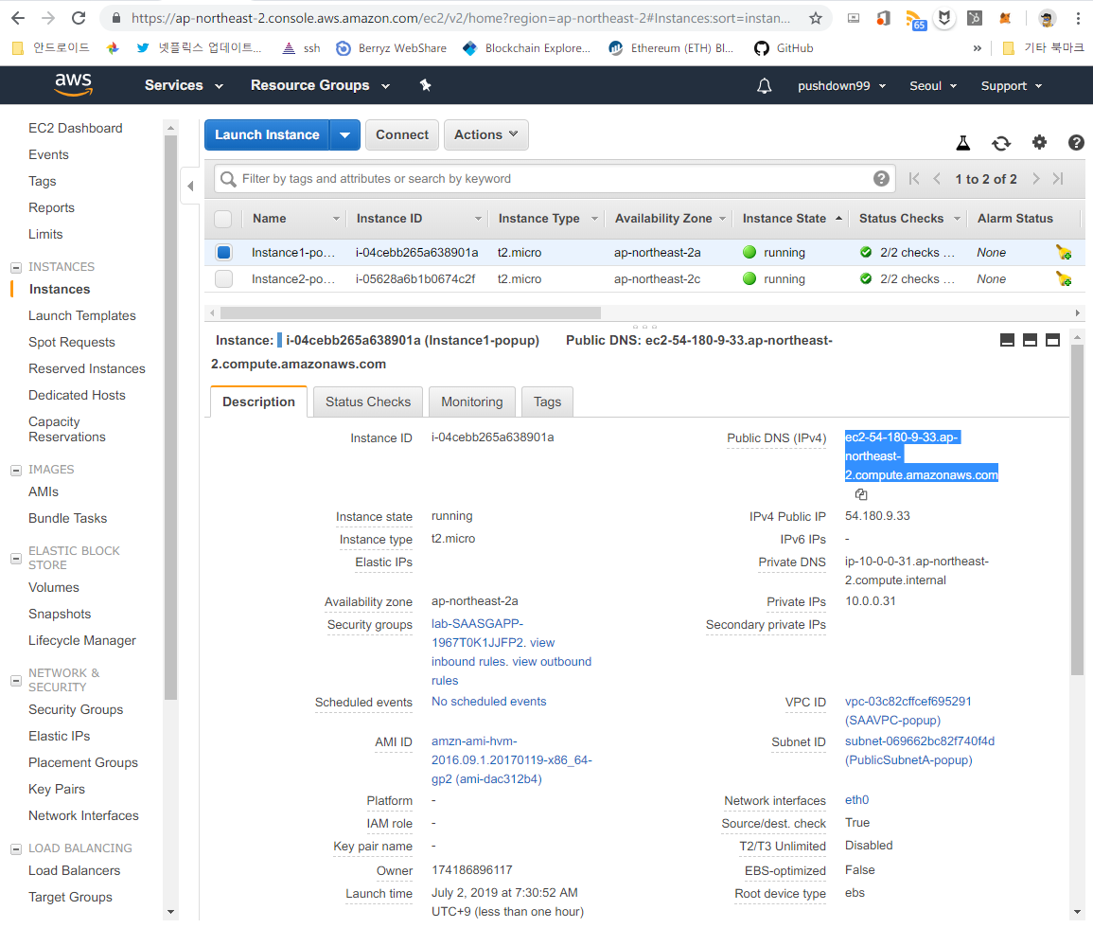
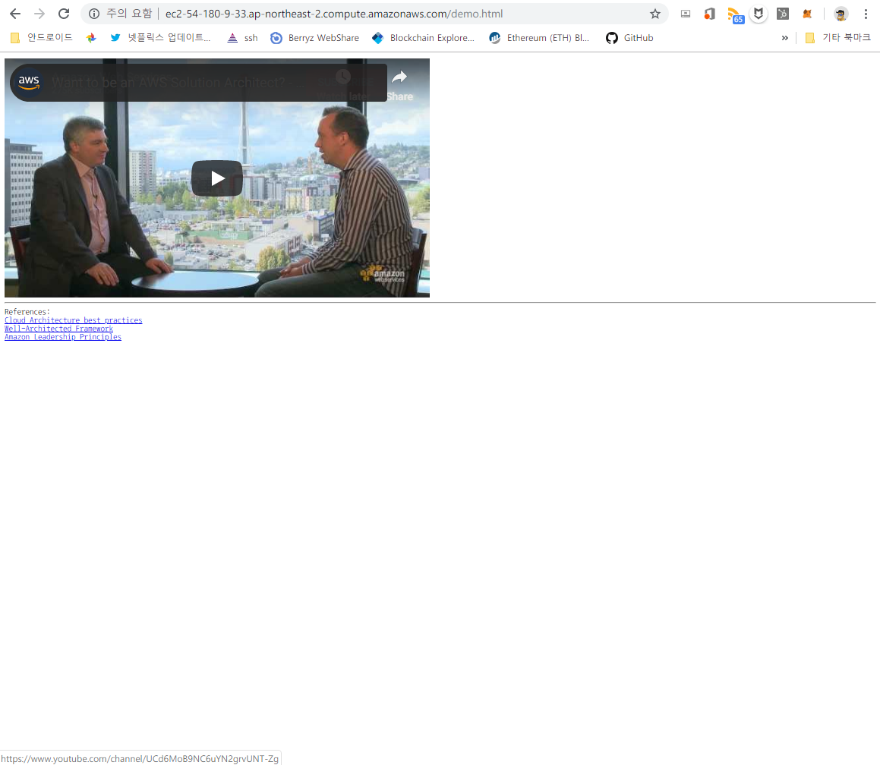
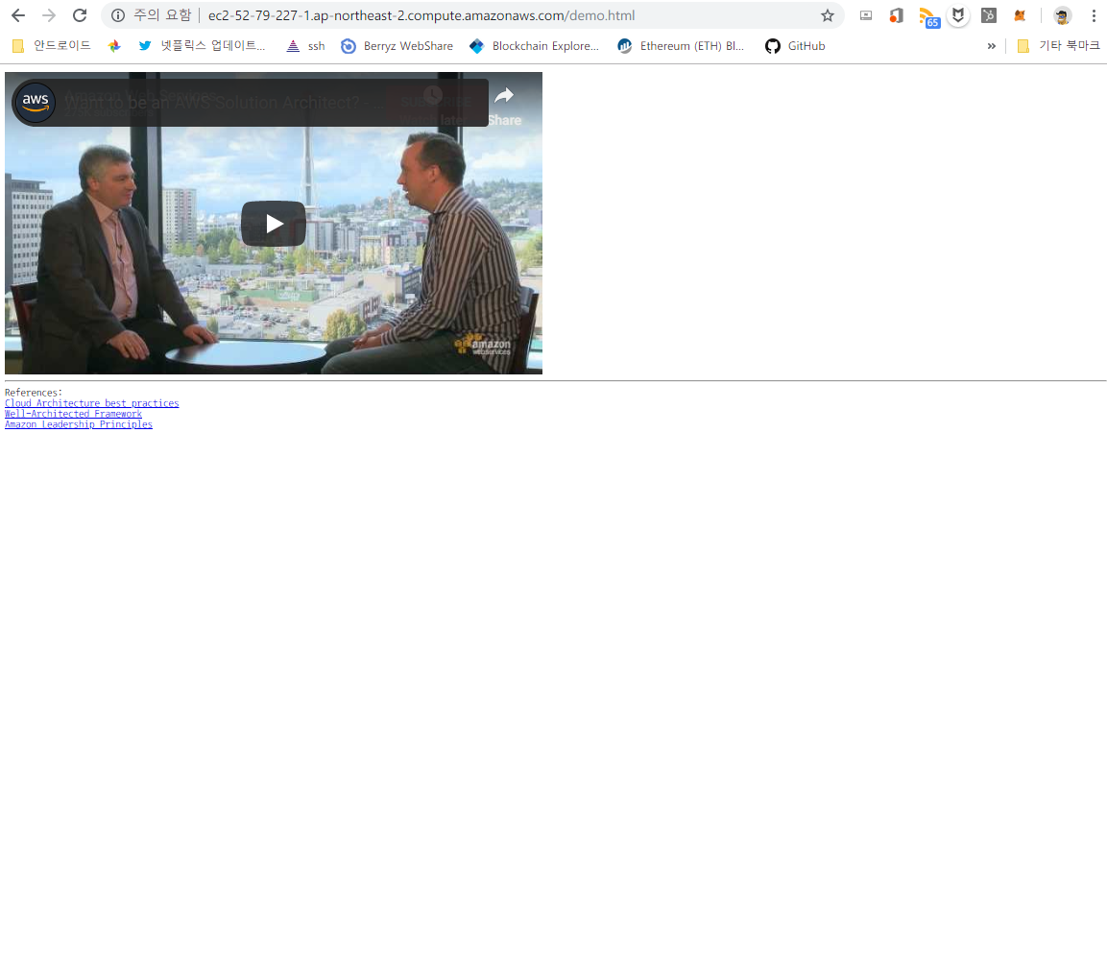
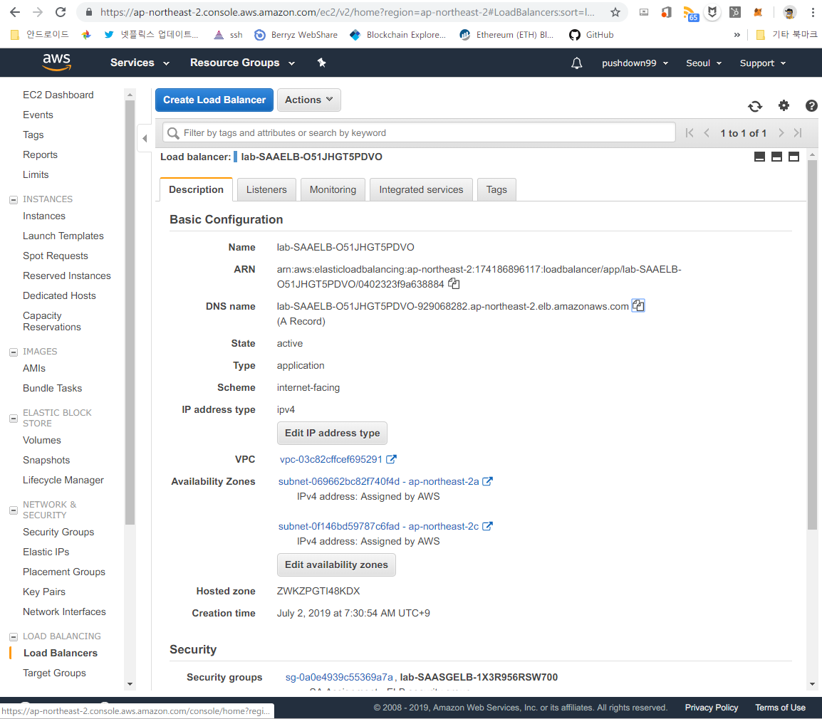
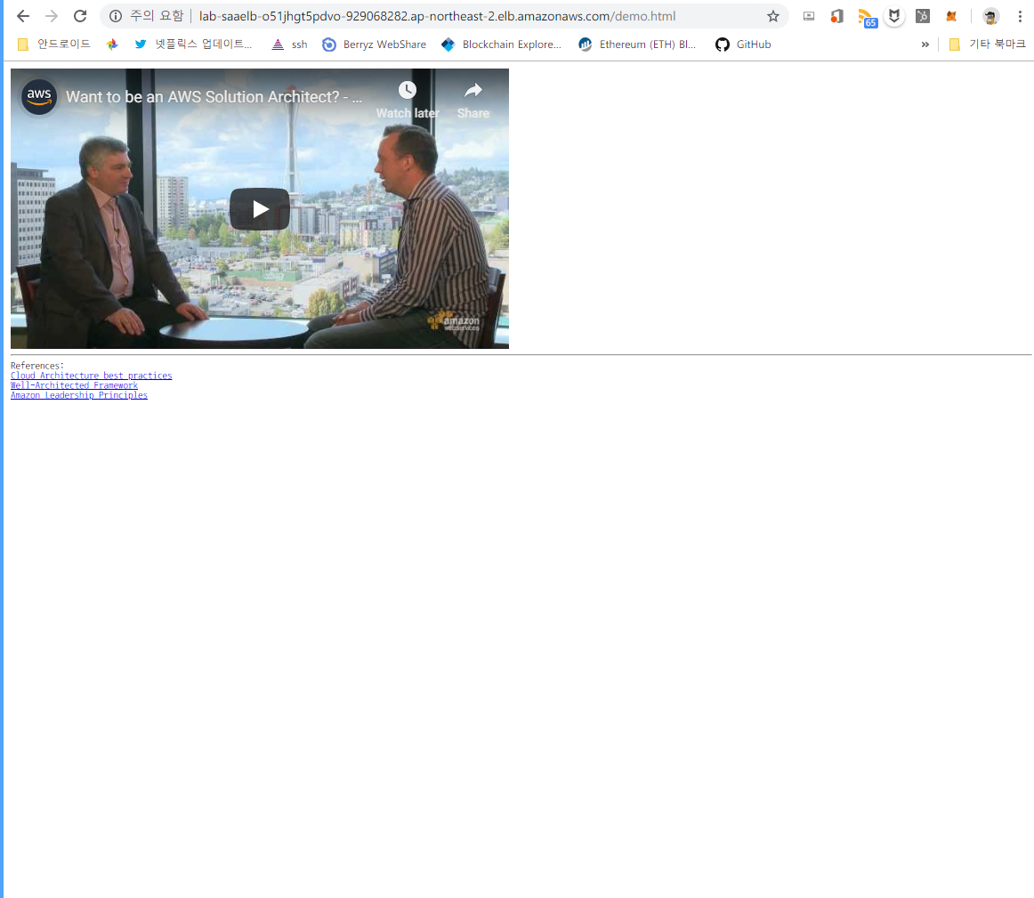
Task #1 :: Demonstration
AWS Console |  | Page (demo.html) Access
EC2
Instance#1
Public DNS
Instance#2
Public DNS
ELB
ELB (application)
DNS

Slide 9
Task#2

Slide 10
Task #2 :: Requirements, 1/2
HA/Reliable/Robust
A Highly available architecture that resists to the failure of single component
Disaster Recovery should be considered in case of multiple components failure
A self-healing infrastructure that recovers from failed service instances
Cost-effectiveness should also be considered across all components of the architecture
High Performance
Configure their database and data access layer for high performance and throughput
Browser very low latency even though a large portion of their user base will be from far away
Effective distribution of load regardless whether it’s http/1.1 or http/2.0 request

Slide 11
Task #2 :: Requirements, 2/2
Security
Security of data at rest and in transit
Securing access to the environment as the delivery team expands
DevOps, Operation/Maintenance
An archival strategy for inactive objects greater than 6 months
Ability to easily manage and replicate multiple environments based on their blueprint architecture.
Application lifecycle management should be considered as a DevOps strategy
Cost-effectiveness should also be considered across all components of the architecture
Access logs generated need to be collected and aggregated for visualization
Scaling to meet the demand, but with uncertainty around when and how much this demand ..

Slide 12






Task #2 :: HA/Reliable/Robust
Design redundant architecture (n+0)
Using dynamic autoscaling architecture w/ event audit
WebServerGroup:
Type: 'AWS::AutoScaling::AutoScalingGroup’
Properties:
DesiredCapacity: '2’
MinSize: '2’
MaxSize: '2'
AWS Cloud
AZ#1
AZ#2
② Invoke EC2 instance
Auto Scaling
WebServerGroup:
Type: 'AWS::AutoScaling::AutoScalingGroup’
Properties:
DesiredCapacity: ‘3’
MinSize: ‘3’
MaxSize: ‘3'
Auto Scaling
Group
EC2
EC2
EC2
EC2
① health check
② Auto Scaling Group
Resource Parameter Update
- resource usage report
RDS / Multi-AZ
EC2 event report
- resource usage report
CloudWatch
RDS
RDS
S3 bucket

Slide 13

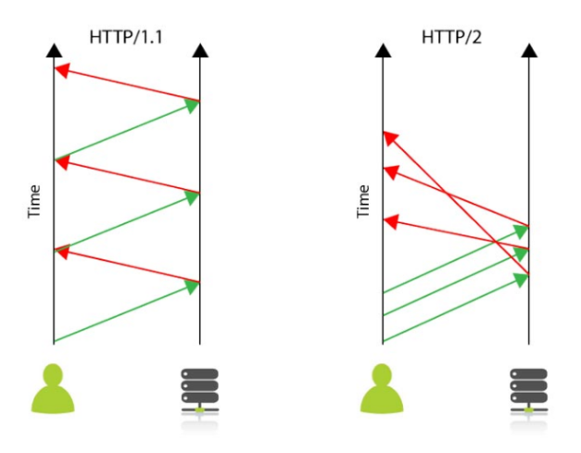
Task #2 :: High Performance
Using ELB(application) → Effective distribution of L7 load (lookup application payload feature)
RDS/Multi-AZ support scale-out DB instance for performance (internal sharding and replica)
CloudFront makes a advanced low latency browsing and oversea traffic performance
contents delivery network
Versionc | HTTP/1 | HTTP/1.1 | HTTP/2 | HTTP/3
Transport | TCP | TCP | TCP | UDP (?)
Persistent connection | x | o | o | -
Overhead HOL blocking RTT increment Low latency | o | o | X Image sprite, domain sharding, css/js compress, Multiplexed Streams
Procedure
ELB type |  | Network/L4 | Application/L7 | UDP support
web traffic
(http/1.1, http/2)
AWS Cloud
CloudFront
AZ#1
AZ#2
③ origin access identity
Auto Scaling
Application
Load Balancer
② web distribution
① Object copy/upload
EC2
EC2
S3
bucket
Primary connection
Secondary connection
RDS / Multi-AZ
Replica-set
RDS
RDS
images: https://bit.ly/2XJbxJY

Slide 14
Task #2 :: Security
Separate all of network-entity
Build a own VPC, isolate between front and back-end nodes, using secure transport (SSL/HTTPS)
Enforce a user access and authorization w/ hierarchy of control thuru role/group/policy
Securing access to the environment as the delivery team expands, IAM
Issue
certificate
Import
certificate
Topologies hidding
Using secure transport
Issue
crypto-key
KMS
ACM
IAM
AWS Cloud
ManagedPolicy
Group | User | Access Control
EC2-admin | A | EC2 instance control/lookup
EC2-support | B | EC2::list*
RDS-admin | C | RDS instance control/lookup
RDS-support | … | RDS ::list*
VPC
Policies
Font-End
Access control
w/ IAM
Group
Role
Private network
User
InstanceProfile
Back-End
AccessKey
EC2 instance
Service

Slide 15
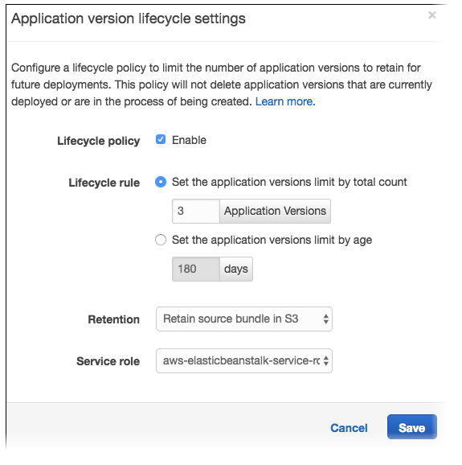
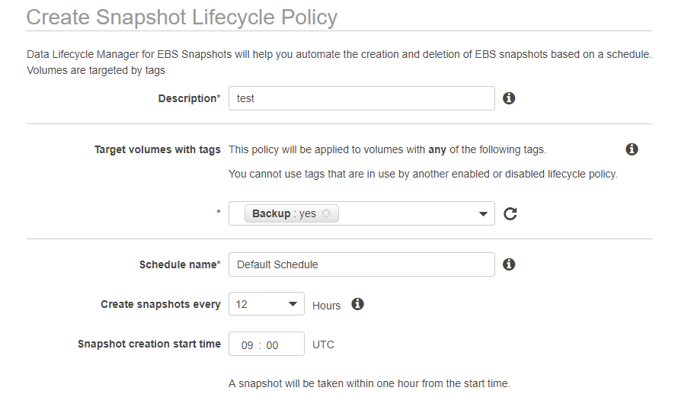
Task #2 :: DevOps, Operation/Maintenance
Managing a Lifecycle policy for an S3 bucket (archiving for inactive objects > 6 months)
and EBS backup image-snapshot, application beanstalk.
Archiving < 6 months S3 Object to CLACIER Storage class Examples
Beanstalk Application, lifecycle setting
<LifecycleConfiguration>
<Rule>
<ID>Transition and Expiration Rule</ID>
<Filter> <Prefix>tax/</Prefix> </Filter>
<Status>Enabled</Status>
<Transition>
<Days>180</Days>
<StorageClass>GLACIER</StorageClass>
</Transition>
<Expiration> <Days>365*5</Days> </Expiration>
</Rule>
</LifecycleConfiguration>
Create EBS snapshot lifecycle policy

Slide 16
Task #2 :: DevOps, Operation/Maintenance
Using diverse deploy method exists.
Automated deploy | CI/CD
CloudFormation
infrastructure automation tools
CodePipeline
Ansible
AWS Stack
Dev
Staging
Production
upload/git
Terraform
S3
*.yaml (*.json)
CodeCommit
CodeDeploy
CodeDeploy
instance
CodeBuild
EC2 instance
EC2 instance
① object/cookbook
chef automate
S3 bucket
AWS OpsWorks
⑤ recipe . run knife / command
docker
Lambda
② trigger
④ wake up lambda
Invoke K8s API
ECR
Kubernetes (K8s)
Lambda
CloudWatch
③ register event, scheduler/callback

Slide 17




Task #2 :: DevOps, Operation/Maintenance
Access logs generated need to be collected and aggregated for visualization
Log probing
Log aggregation and store
Visualization
Messaging
trigger
Predefined Event
Alarm
Rule
EC2 instance
CloudWatch
CloudWatch Metrics and Graph
install CloudWatch logs agent
using Instance ‘userdata’
Event
(event-based)
Event (time-based)
sudo yum update –y
sudo yum install –y awslogs
edit /etc/awslogs/awslogs.conf
edit /etc/awslogs/awscli.conf
sudo service awslogs start
Amazon ES
EC2 local logs
Event Log
Lookup
S3 bucket, Extract
Indexing, data store
CloudTrail
S3 bucket
Amazon Lambda
Dashboard
Cloud rail Event Log
Messaging
trigger
messaging
Lambda trigger
Amazon SNS
ELK stack

Slide 18
Conclusion

Slide 19
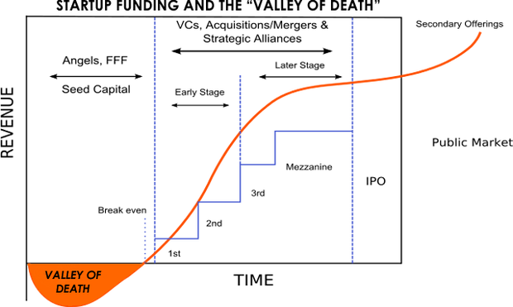
Conclusion :: At a glance, our customer
I was a freelance cloud architect, so I met and talked my customer for finding their real needs and problems.
→ Customer does not have much money, but want to build and operation on cloud
Customer persona-model
Start-up company (founded in less than 1 years)
Proof of concept (PoC) stage, but want a deploy on AWS cloud
Full-time employee: 4~5
Stock holder's equity: ~ $ 250,000 (But, most money is used as employee salary)
What they really want?
Cost-effective cloud model, monthly subscribe model.
Initially, they want a more cheaper architecture model, but they will be aimed a scalability and global region
They want to know exactly how much money they have to spend. on their business plan.
Here
< $ 1,500 / monthly

Slide 20
Conclusion :: guessing, our customer service
My customer prepare the mobile media service that needs a API servers and databases on cloud. In order to show the service to VC / investor for seed money, at least 10,000 users and using 5 time in daily per should be secured.
→ So, I have a simulation traffic and capacity for user service. Then, induced below results.
. Service Capa. Simulation : Instance Selection Guiding: Instance-type: Large type / 340GiB EBS
[1] User | 10,000
[2] Service Attempt (per user) | 0.2 / hour
[3] Mean hold time | 200 sec
[4] Concurrent Service | 110/sec | [1]*[2]*[3]/60/60
[5] Transaction | 670 | [4]*6
[6] tpmC | 52,000 | [5]*60*130%
[7] Iops | 2,680 | [4]*4
[8] Storage Volume | 340 GiB | EBS / Iops ratio
Instance | #vCPU | tpmC(e)
Small | 1 | 42,253
Large | 2 | 82,506
Xlarge | 4 | 165,012
2xlarge | 8 | 330,024
4xlarge | 16 | 660,048
Reference HW: large/2.4GHz intel/xeon® E5-2676 v3(Haswell)

Slide 21

Conclusion :: Proposal architecture
My customer needs a cost-effective cloud architecture (endure 10,000 user service and less money to pay monthly)
→ So, I propose minimal-size cloud architecture. but, it was solving the reliability, security, cost, operation and performance needs.
Cost-effective AWS cloud architecture
$1,383 < Expected budget = $ 1,500
Seoul Region (ap-northeast-2)
AWS Cloud
model | Unit | Cost | Description
EC2 (t3.xlarge) | 2 | $ 609
EBS (340GB) | 2
EIP | 1
S3 (1000GB) | 1
ELB/Application | 1
RDS /MySQL/Multi AZ (db.t2.large) | 2
CloudWatch (5 x 5, 1min) | 1
IAM
Total |  | $ 1,383 | < $1,500
AZ#1
AZ#2
VPC
Internet
Gateway
EIP
Auto Scaling
Application
Load Balancer
EBS
S3
bucket
EBS
EC2
EC2
Primary connection
RDS / Multi-AZ
CloudWatch
Replica-set
RDS
RDS

Slide 22
Conclusion :: Explain the propose architecture
I derived a some keyword for facing user problem and needs (improve the reliability, security, cost, operation and performance before the project goes into production) previous chapter.
Architecture (Redundancy, Distributed model) for HA
Load balancing for application level
Consider scale-up and scale-out
Network virtualization, isolation, crypto for data and transit security
IAM hierarchy scheme apply for diverse delivery team
Easy deploy, operation and support visualization

Slide 23
Conclusion :: Scaling meet the customer demands
Considerations | Service | Using/Scale-out Checkpoint | Add on service (for large-scale and global biz)
HA architecture (for zero downtime) | Dual EC2 (+EBS) w/ auto-scaling S3 RDS | When increasing user and traffic (2,600 tpmC /+EC2) | Consider DB Clustering
Resist to regional failure | Using different regions (VPC and RDS/Multi-AZ)
Support security | Using HTTPS (with certification) Network virtualization (VPC) and topology hidding with public and private subnet segmentation. Access-control with IAM (prepare policy and group, then allocate group to user/delivery team) | Each service policy and permission divided 3 grade with admin / operation (start/stop)/ support (view)
Performance | Using Application LoadBalancer (some latency exist) Apply service grouping (like RDS/multi-AZ, autoscale) |  | CloudFront
Operation / Visualization | using AWS admin console and CloudWatch dashboard (monitoring component event – predefined and save to S3 bucket) Using CloudWatch agent logs on EC2 (pre-install) |  | Lambda SNS ES

Slide 24
Conclusion :: Scaling meet the customer demands
Considerations | Service | Using/Scale-out Checkpoint | Add on service (for large-scale and global biz)
instance/object/data life cycle management | Using AMI and snapshot service for EC2 S3 bucket life-cycle mgmt.’ EBS backup schedule | Daily backup Expired S3 bucket objects will be archiving and removed
DR (backup and restore) | Restore EC2 w/ AMI or backup snapshot Restore backup EBS
Blueprint deploy | Using CloudFormation(+ansible) for infrastructure |  | OpsWorks Beanstalk
CI/CD | Manually deploy (using git tool) |  | CodePipeline (CodeCommit, CodeDeploy) ECR K8s

